Slide 1

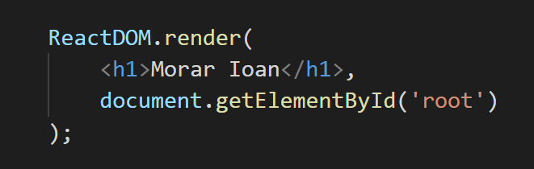
React.js
BEGINNER LEVEL

Slide 2


Who am I?
Experienced Web Developer.
Skilled in C#, .NET MVC,
Sql Server and some frontend technologies
like React (Javascript ES6),
Typescript, HTML5, CSS/LESS.
Strong engineering professional
graduated at „Transilvania” University from Brașov.

Slide 3
What do we do today?
React or not React?
What is it?
How it works?
Why do we need it?
2. Create small application using React
Javascript
Component, state/props
Lifecycle methods
Coffee break: 15:45 – 16:00

Slide 4
What is it?
React is a declarative, efficient, and flexible
JavaScript library for building user interfaces.
It lets you compose complex Uis
from small and isolated pieces of code
called “components”.

Slide 5
Virtual DOM
is an abstraction of the HTML DOM. It is detached
from the browser-specific implementation details.
The Virtual DOM is a programming concept
where a representation of a UI is kept in memory
and synced with the “real” DOM by a library
such as ReactDOM.
For every DOM object,
there is a corresponding "virtual DOM object."

Slide 6
Reconciliation
is the process through which React updates the DOM.
When a component's state changes,
React has to calculate if it is necessary to update the DOM.
It does this by unmounting the whole virtual DOM (tree)
and create a new one, comparing it with the current DOM.
Virtual DOM 1
State 1
get all the differences
discovers optimal changes
comparison
SetState
Yes
NO
Virtual DOM 2
State 2
“Redraw” DOM
Stop!

Slide 7
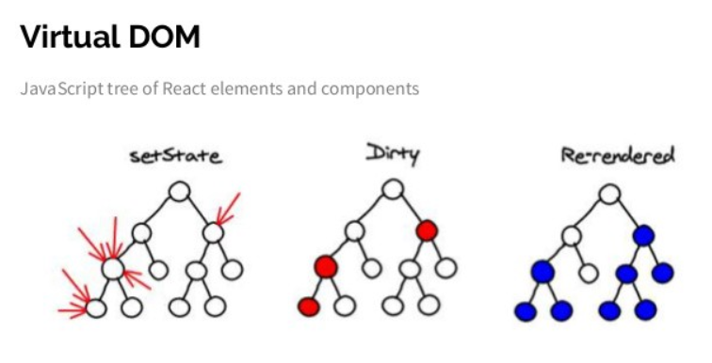

Slide 8
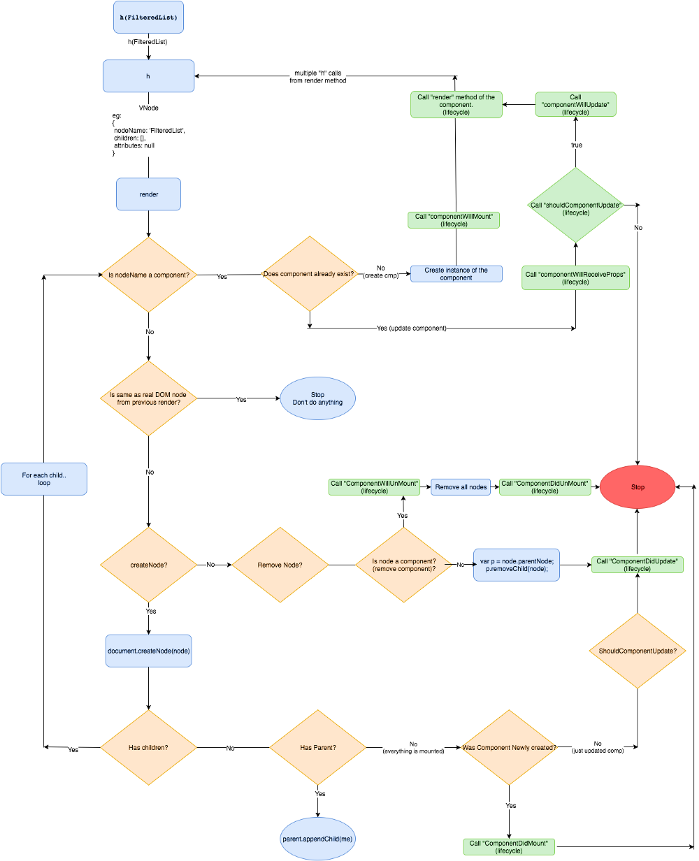

Slide 9
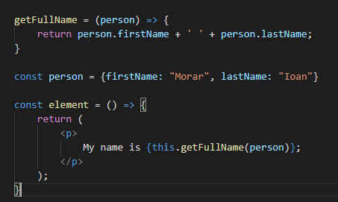
JXS
it is a syntax extension to JavaScript.
Using JSX you can write concise HTML in the same file
as you write JavaScript code, then Babel will transform
these expressions into actual JavaScript code.
- Is not mandatory to use JSX with React

Slide 10
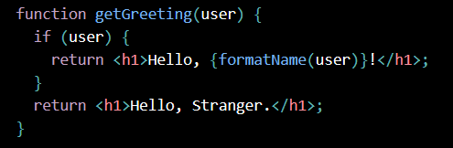
JXS
After compilation, JSX expressions become regular JavaScript function calls and evaluate to JavaScript objects.
This means that you can use JSX inside:
inside of if statements and for loops
assign it to variables
accept it as arguments in a function
return it from functions

Slide 11
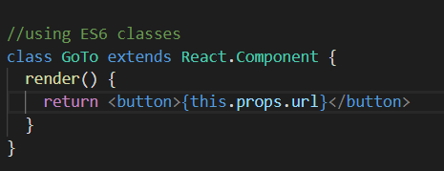
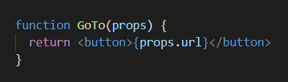
Components
let you split the UI into independent, reusable pieces, and think about each piece in isolation
Conceptually, components are like JavaScript functions that receive props and return a React element
Can be defined using a function or a class

Slide 12
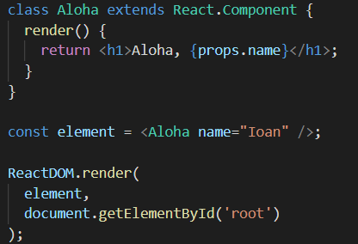
Rendering a Component
To render a React element into a root DOM node,
pass both to ReactDOM.render():
Always start component names with a capital letter.
React treats components starting with lowercase letters as DOM tags. ( <div /> etc)

Slide 13
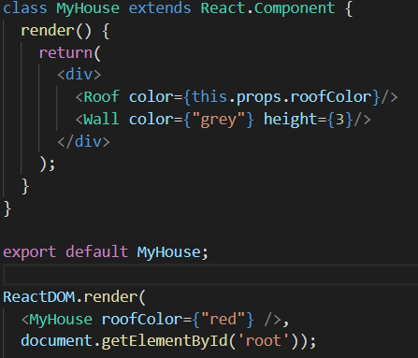
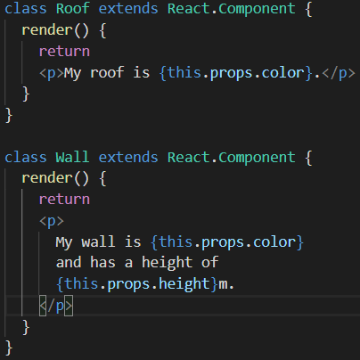
Composing Components
Components can refer to other components in their output.

Slide 14
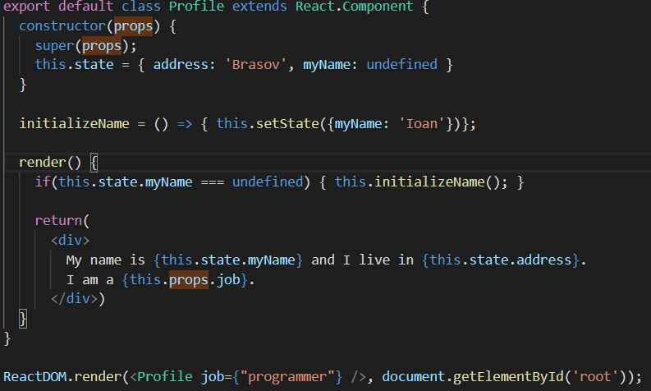
PROPS, STATE
Props are Read-Only
State it is private and fully controlled by the component.
Class components (that have a local state) should always
all the base constructor with props

Slide 15
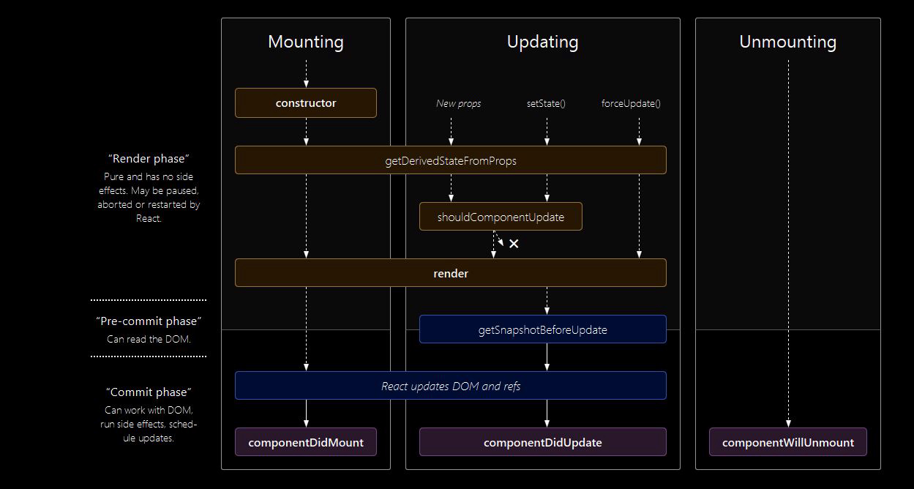
Lifecycle methods

Slide 16
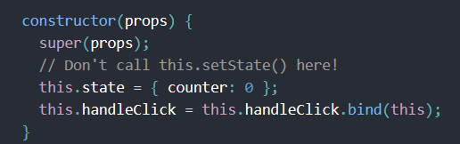
constructor()
is called before component it is mounted
Initializing local state by assigning an object to this.state
Binding event handler methods to an instance

Slide 17
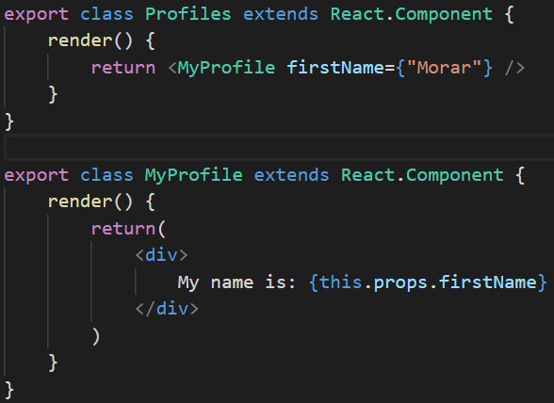
render()
is the only required method in a class component
When called, it should examine this.props and this.state and return one of the
following: an element, string, numbers, boolean or null, arrays, fragments, portals
should be pure, meaning that it does not modify component state,
it returns the same result each time it’s invoked
will not be called if shouldComponentUpdate will return “false”

Slide 18
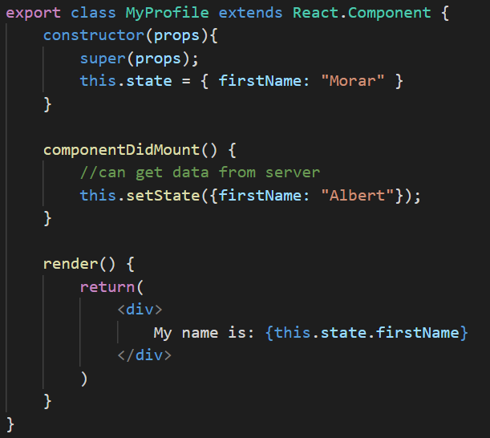
componentDidMount()
is invoked immediately after a component is mounted
This method is a good place for:
- initialization that requires DOM
- load data from a remote endpoint
We can also call setState =>
=> It will trigger an extra rendering, but it will happen before the browser updates the screen

Slide 19
shouldComponentUpdate(nextProps, nextState)
Used to let React know if a component’s output
is not affected by the current change in state or props
is invoked before rendering when new props
or state are being received
Return true by default
is not called for the initial render or
when forceUpdate() is used
Consider using the built-in PureComponent instead of writing shouldComponentUpdate()
by hand. PureComponent performs a shallow comparison of props and state,
and reduces the chance that you’ll skip a necessary update.

Slide 20
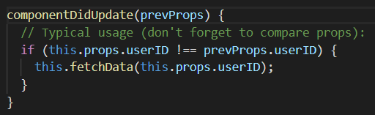
componentDidUpdate(prevProps, prevState)
is invoked immediately after updating occurs
We can reload data from server
We can call setState() but note that it must be wrapped
in a condition like in the example above, or you’ll cause
an infinite loop
will not be invoked if shouldComponentUpdate() returns false

Slide 21
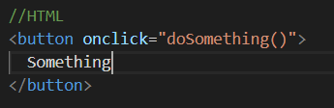
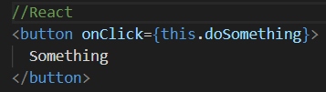
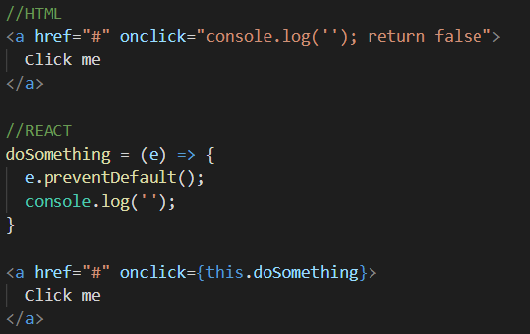
Handling Events
React events are named using camelCase, rather than lowercase
With JSX you pass a function as the event handler, rather than a string
Another difference is that you cannot return false to prevent
default behavior in React. You must call preventDefault explicitly

Slide 22
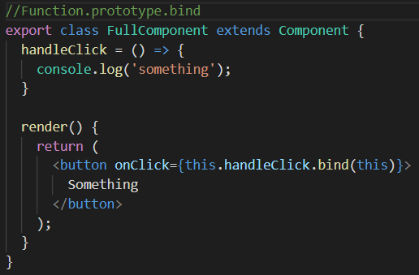
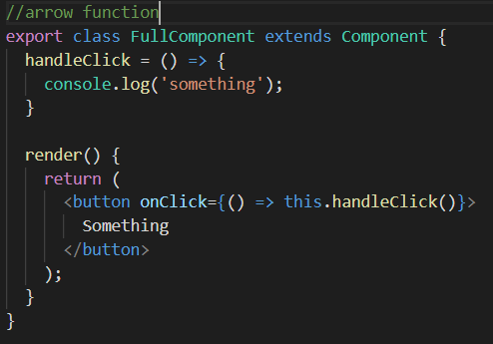

Handling Events
if you refer to a method without () after it, such as onClick={this.handleClick},
you should bind that method
Passing Arguments
In both cases, the e argument representing the React event will be passed as a
Second argument after the ID. With an arrow function, we have to pass it explicitly,
but with bind any further arguments are automatically forwarded.

Slide 23
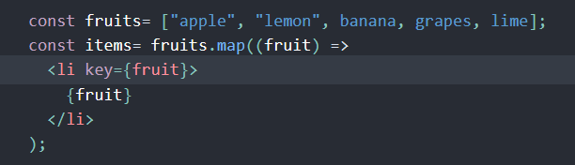
Keys
Keys help React identify which items have changed,
are added, or are removed. Keys should be given to the elements
inside the array to give the elements a stable identity:
If we add or remove some elements in the future or change
the order of the dynamically created elements,
React will use the key values to keep track of each element.

Slide 24
Example
Lifting State Up
How to update something on the Parent component from a child

Slide 25
Q&A

